Slide 1
N_{mass}

Slide 2
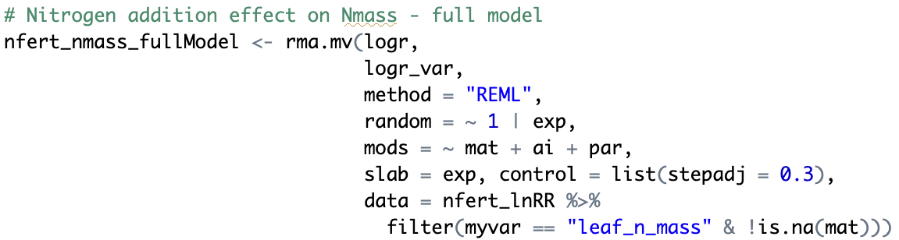
Climate moderator models

Slide 3
N_{area}

Slide 4
P_{mass}

Slide 5
P_{area}

Slide 6
M_{area}

Slide 7
Leaf N:P
(cool interaction effect: synergy
is only observed when demand is high)

Slide 8
Aboveground
biomass
(cool interaction effect: synergy
is only observed when demand is high)

Slide 9
Some main takeaways
Interactions between N and P are only apparent under conditions where demand is high
Climate seems to have stronger control on area-based leaf N and P
In general, MAT controls leaf nutrient response to nutrient additions (but in some cases PAR, too)

